Slide 1
Distributed Computing & Spark with Azure Databricks
Avanade ASG Data Science Bootcamp

Slide 2
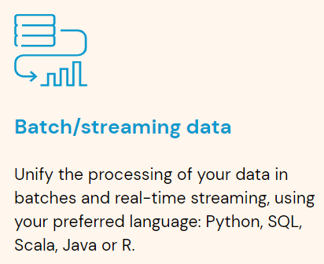
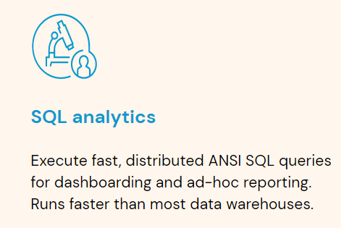
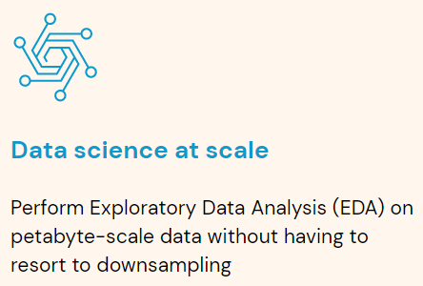
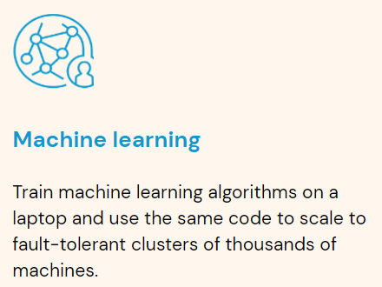
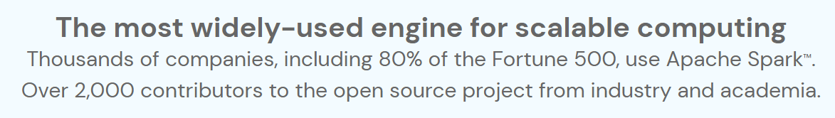
What is Spark? (1/2)
Apache Spark is a simple, fast, and scalable unified multi-language engine for large-scale data analytics
Unified: Data Engineering, Data Science, Machine Learning, Business Intelligence
Multi-language: High-level APIs in Python, SQL, Scala, Java, R
Large-scale: single-node machines or multi-node clusters

Slide 3
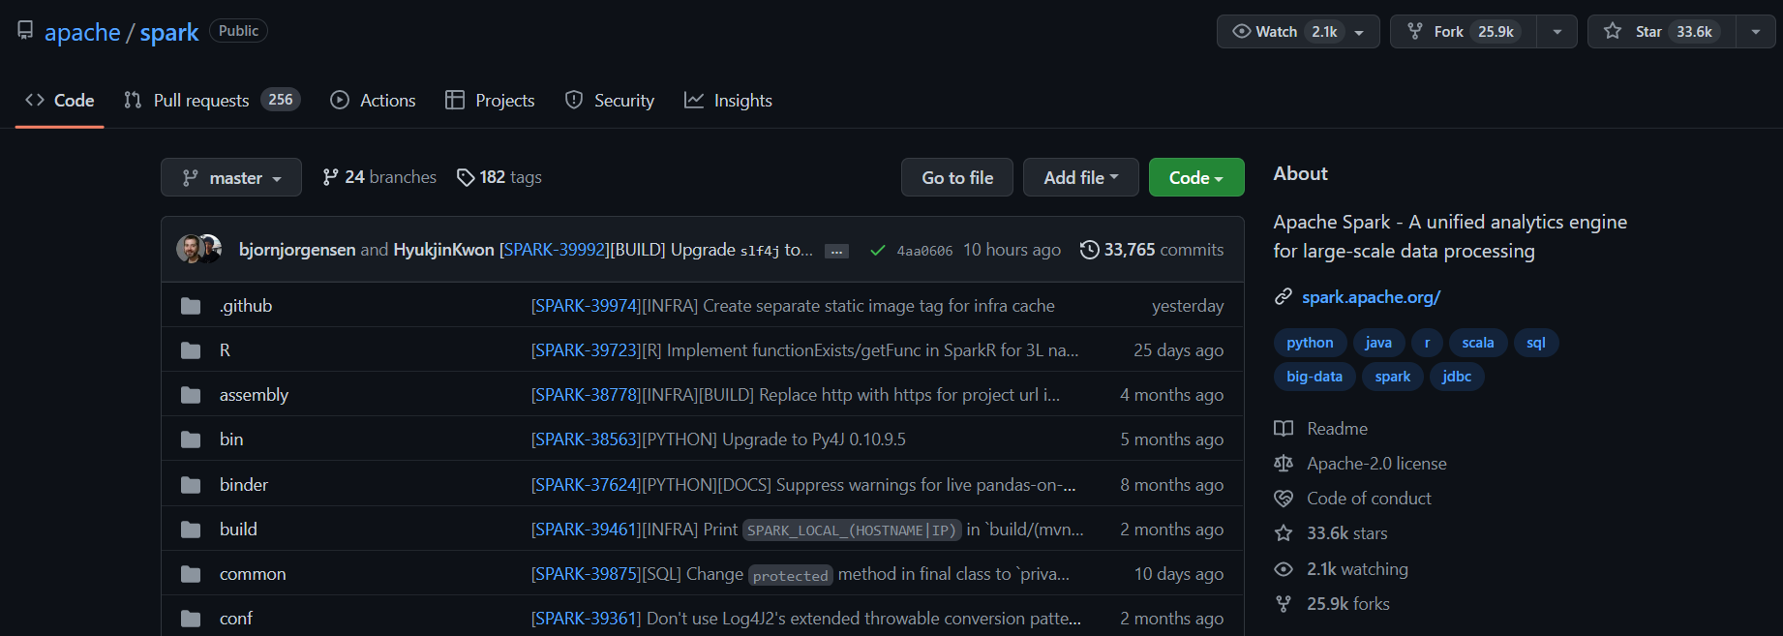
What is Spark? (2/2)
Spark is an open-source project written mostly in Scala, available on Github. This means that you could become a contributor!
https://github.com/apache/spark

Slide 4
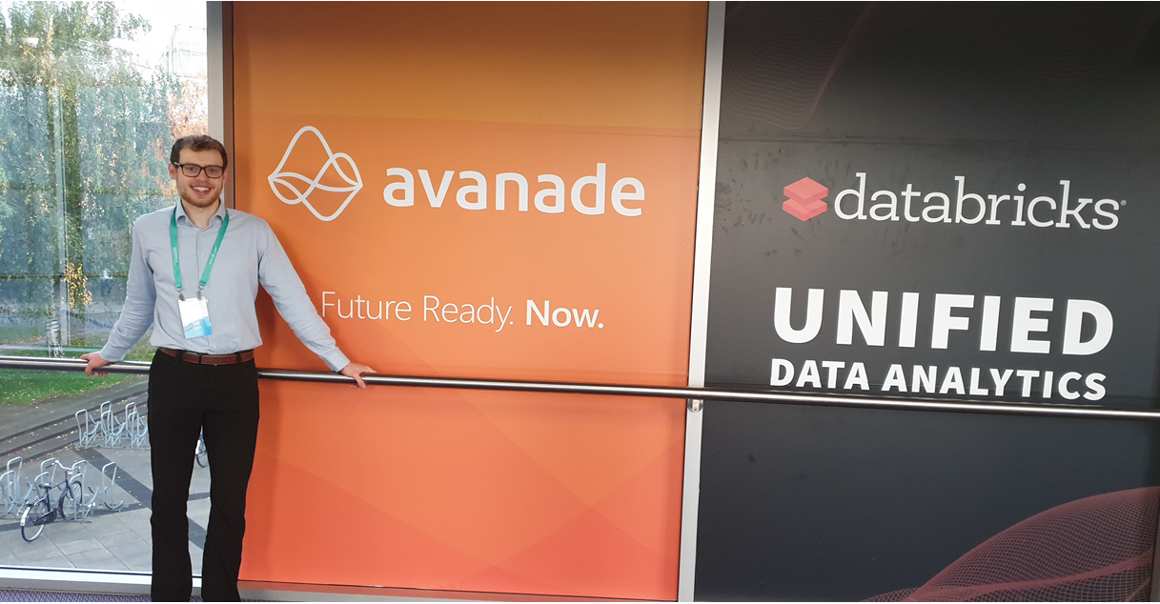
Spark & Databricks History
2009:
Spark starts as a research project at UC Berkeley in California by a couple of PhD students
2010:
Spark is open sourced
2013:
The project is donated to the Apache Software Foundation
The creators of Apache Spark found a company called Databricks to offer a web-based platform for working with Spark
2014:
In February, Spark becomes a top-level Apache project
In November, Databricks sets a new world record in large scale sorting using Spark
2019
Spark & AI Summit in Amsterdam with 2300 people. Avanade first time named Databricks partner of the year
Today:
Spark: 600,000+ lines of code built by 1800+ developers from hundreds of organizations (main contributor: by far Databricks)

Slide 5
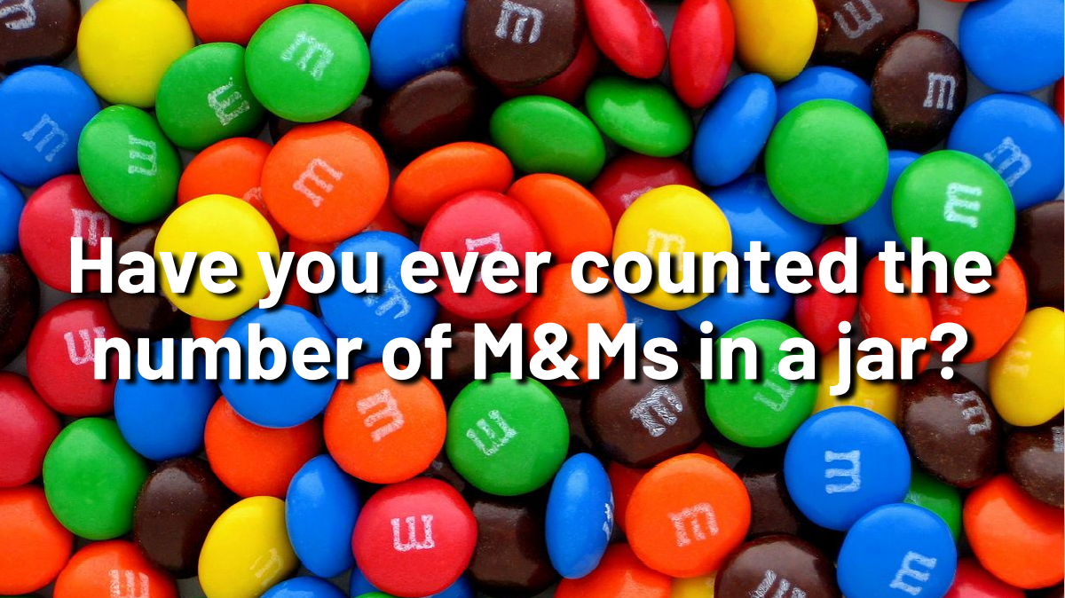
Motivation
Think of an effective (fast) strategy to do so
What resources do you need?
Which steps do you follow?

Slide 6
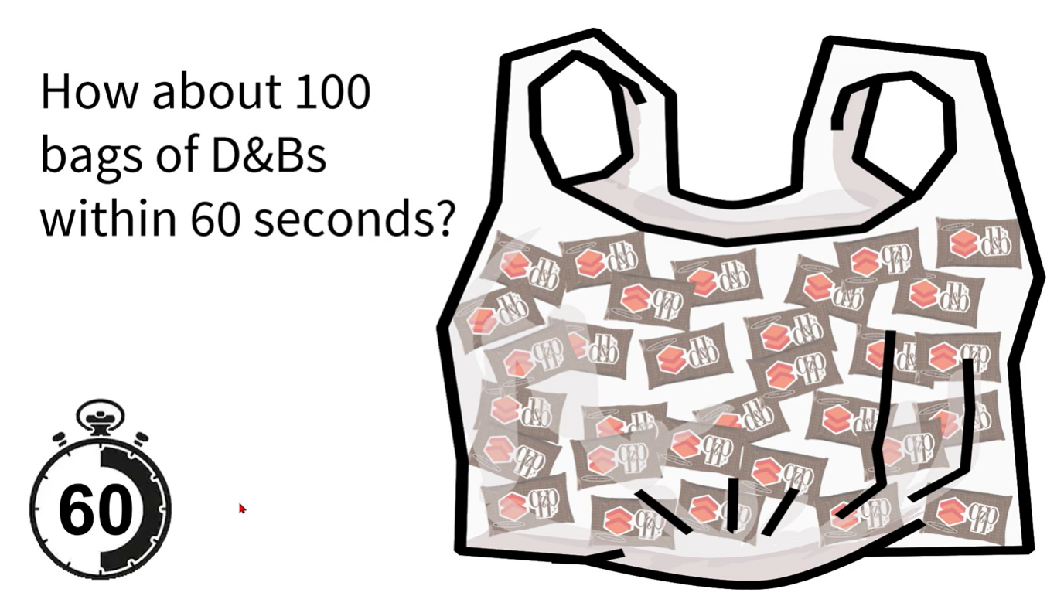
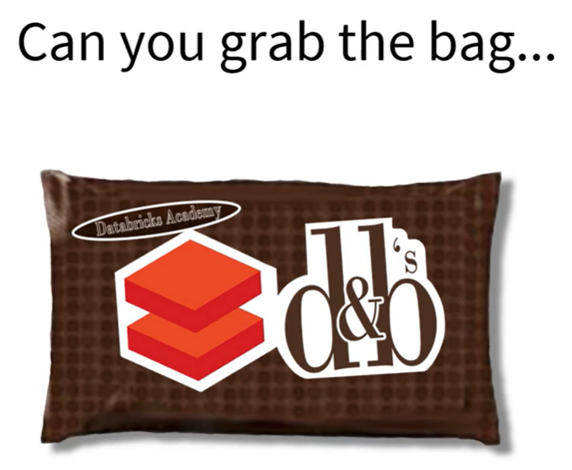
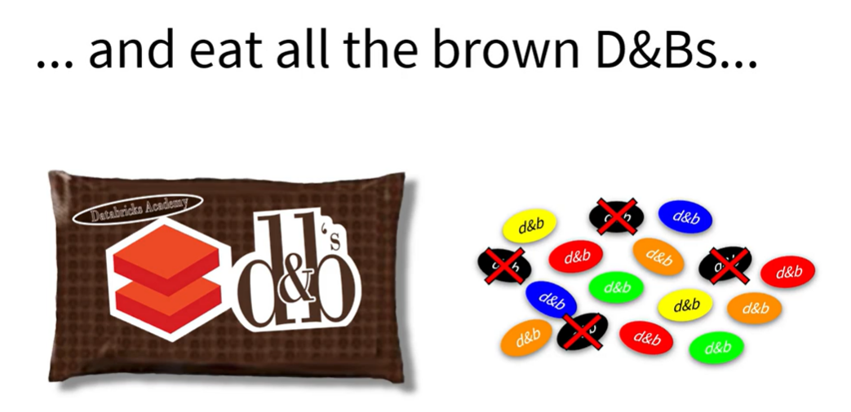
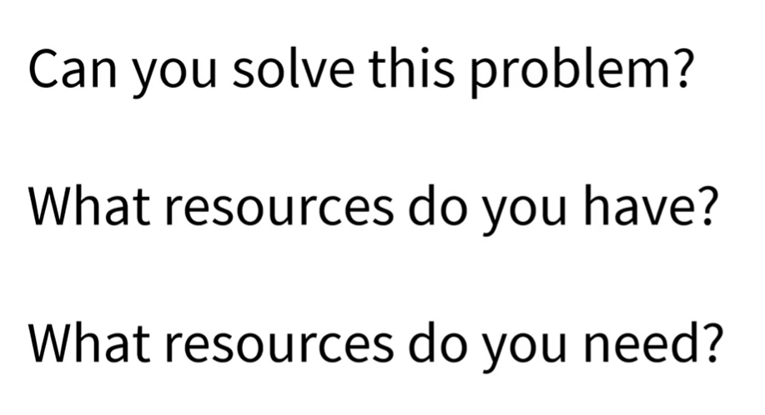

Motivation

Slide 7
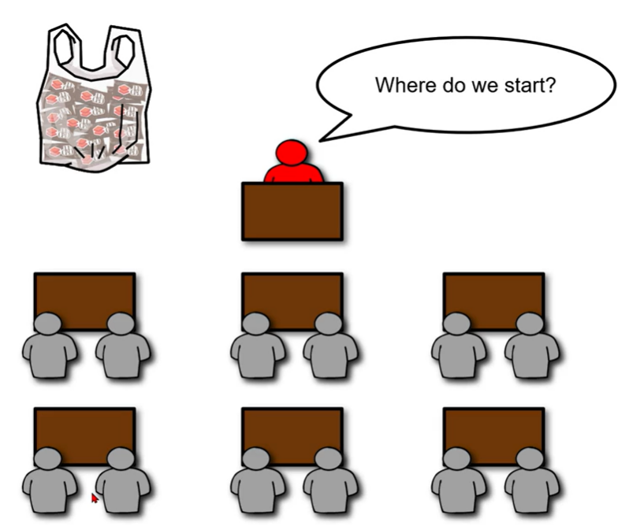
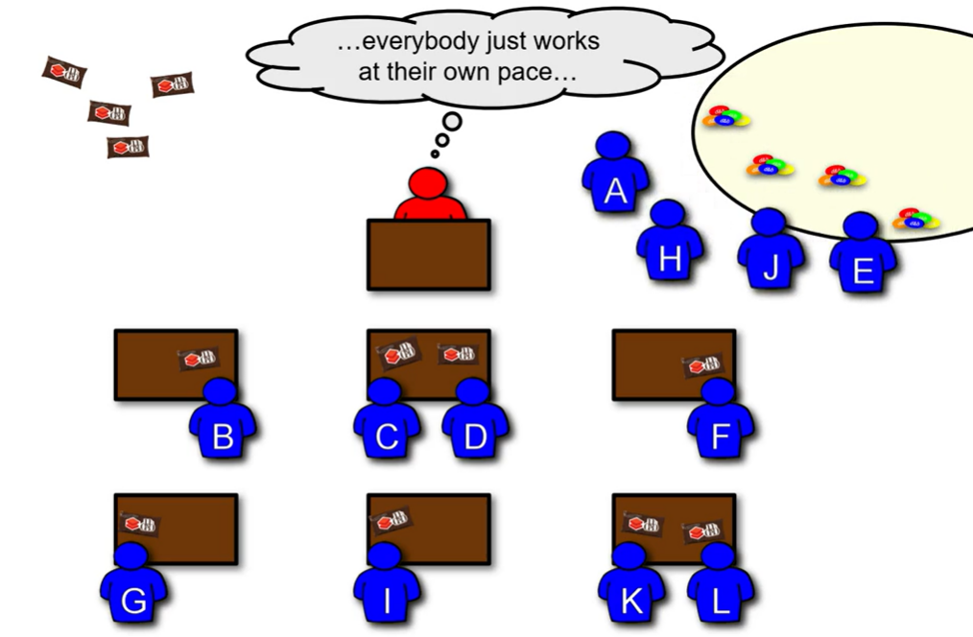
Motivation
https://partner-academy.databricks.com/learn/course/112/play/1702:303/introduction-to-apache-spark-architecture -> Filtering – The Analogy Video
Notes:
A table (or place to work)
A place from which one can retrieve the M&Ms and store them on count completion
People to process the M&Ms
An orchestrator

Slide 8
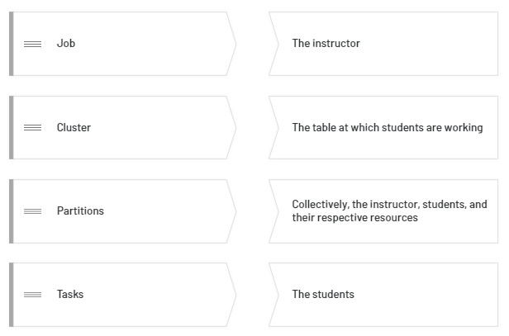
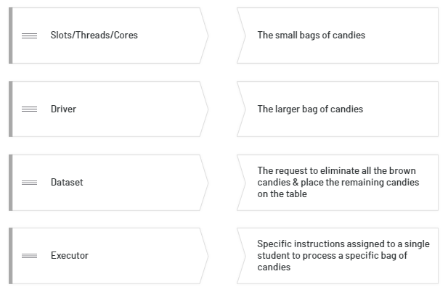
Spark Architecture
Task: match each Spark architecture concept with the respective component in the analogy

Slide 9
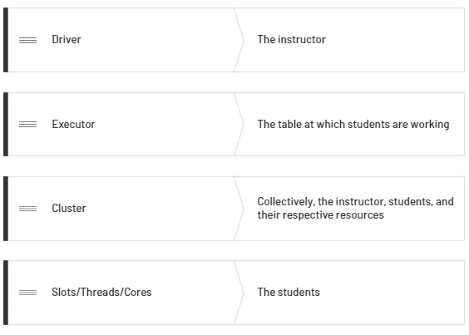
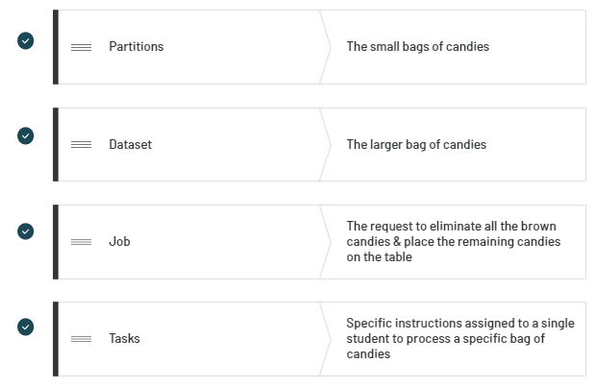
Spark Architecture
Solution

Slide 10
Spark Architecture Breakdown
https://partner-academy.databricks.com/learn/course/112/play/1702:303/introduction-to-apache-spark-architecture -> Filtering – Breaking Down the Analogy Video
Notes:
A table (or place to work)
A place from which one can retrieve the M&Ms and store them on count completion
People to process the M&Ms
An orchestrator

Slide 11
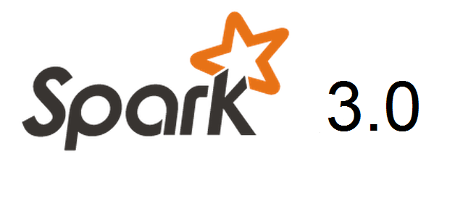
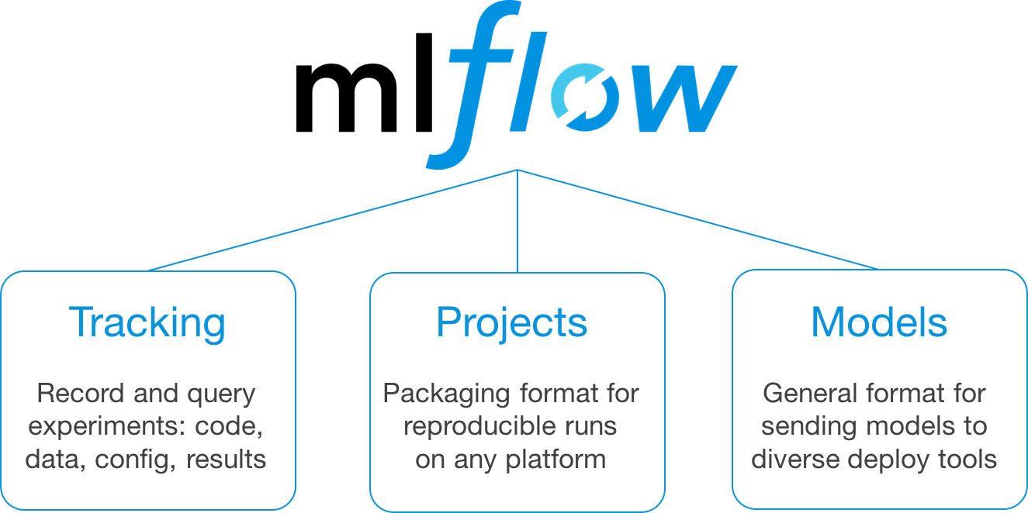


Databricks
https://docs.databricks.com/?_ga=2.26086267.718267847.1659725083-830162552.1639937423

Slide 12

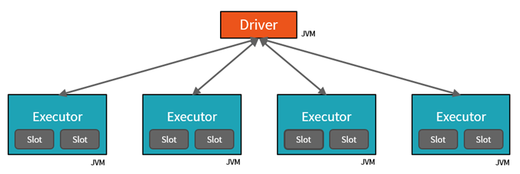
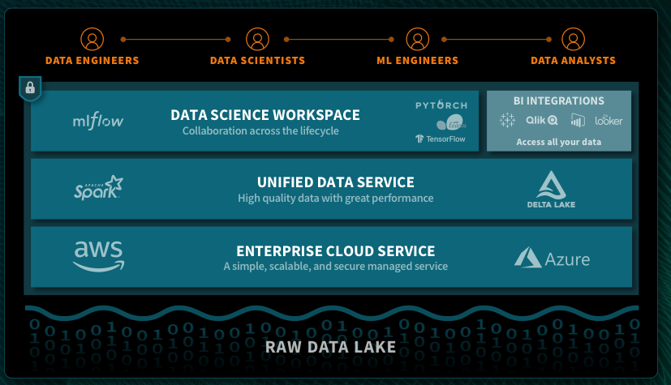
Databricks in a Nutshell Unified Analytics Platform for big data
Founded by the original creator of Spark
Main contributor to the Spark open source project.
Distributed in-memory processing engine Spark
Compute platform without native storage
A unified analytics platform on top of Spark for data scientists, data engineers and business analysts
Fully managed, scalable, and secure cloud infrastructure that reduces operational complexity and total cost of ownership
Handy notebook format (like Jupyter Notebooks)
Notes:
Why is it worthwhile to optimize? Transportation costs are going up in all markets.
Network adjustments: opening and closing new plants External Factors: adjustments in transportation costs between two sites
Sweet Spot Analysis: Where is the optimum? Transportations costs, Networking Capital, Service Level

Slide 13
Azure Databricks Apache Spark + Databricks + Enterprise Cloud = Azure Databricks
Start quickly with an optimized Apache Spark environment: Just spin up a cluster and take advantage of autoscaling and auto-termination to improve TCO.
Boost productivity with a shared workspace and notebook experience as well as common languages such as Python, Scala, SQL and R.
Get easy version control with GitHub and Azure DevOps
Turbocharge machine learning on big data: Make use of the Spark MLlib, scikit learn, keras (...) or access advanced automated machine learning capabilities using the integrated Azure Machine Learning service
Receive unmatched levels of performance and scalability for big data processing and data transformations
Notes:
Clusters are set up, configured, and fine-tuned to ensure reliability and performance without the need for monitoring.

Slide 14

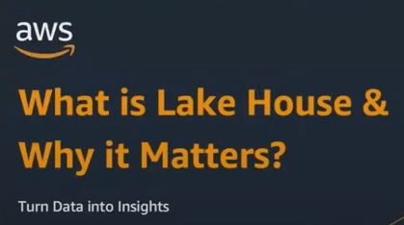
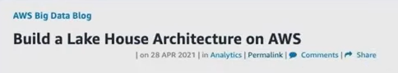




Databricks Overview
Databricks is more than just a Data Science platform. It is a holistic Data platform but as of now particularly shines on Data Science workloads. They have invented the Lakehouse paradigm, which is revolutionizing the data platform industry.
This paradigm has been picked up and prioritized by all major cloud vendors, slowly but surely replacing traditional data warehouse offerings.
Source: Data & AI Summit 2022 Keynote
Notes:
Clusters are set up, configured, and fine-tuned to ensure reliability and performance without the need for monitoring.

Slide 15
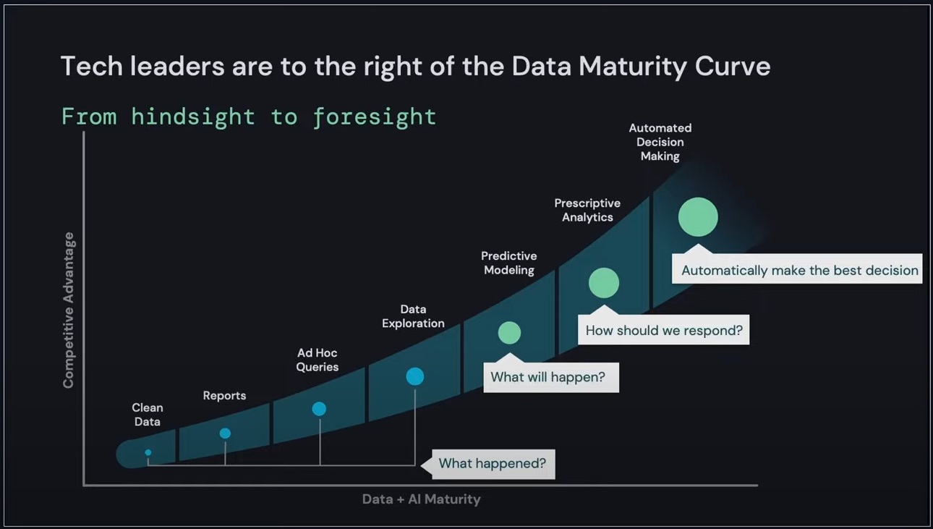
Lakehouse Motivation (1/4)
Source: Data & AI Summit 2022 Keynote
Notes:
Clusters are set up, configured, and fine-tuned to ensure reliability and performance without the need for monitoring.

Slide 16
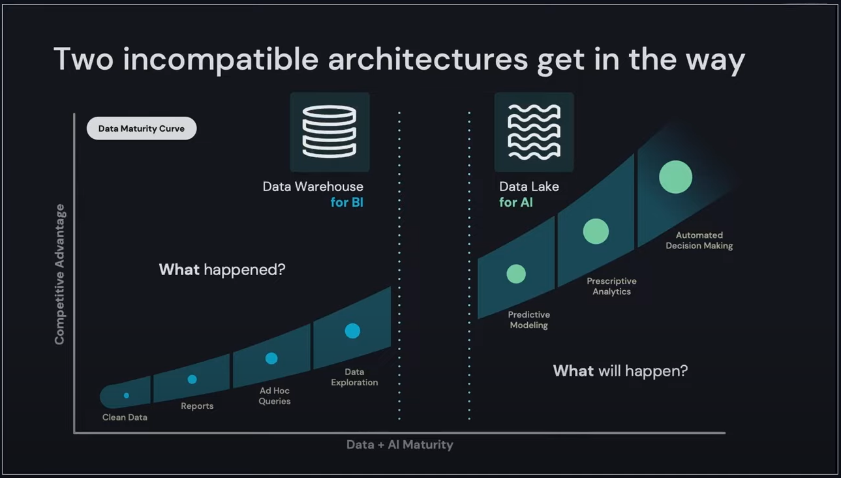
Lakehouse Motivation (2/4)
Source: Data & AI Summit 2022 Keynote
Notes:
Clusters are set up, configured, and fine-tuned to ensure reliability and performance without the need for monitoring.

Slide 17
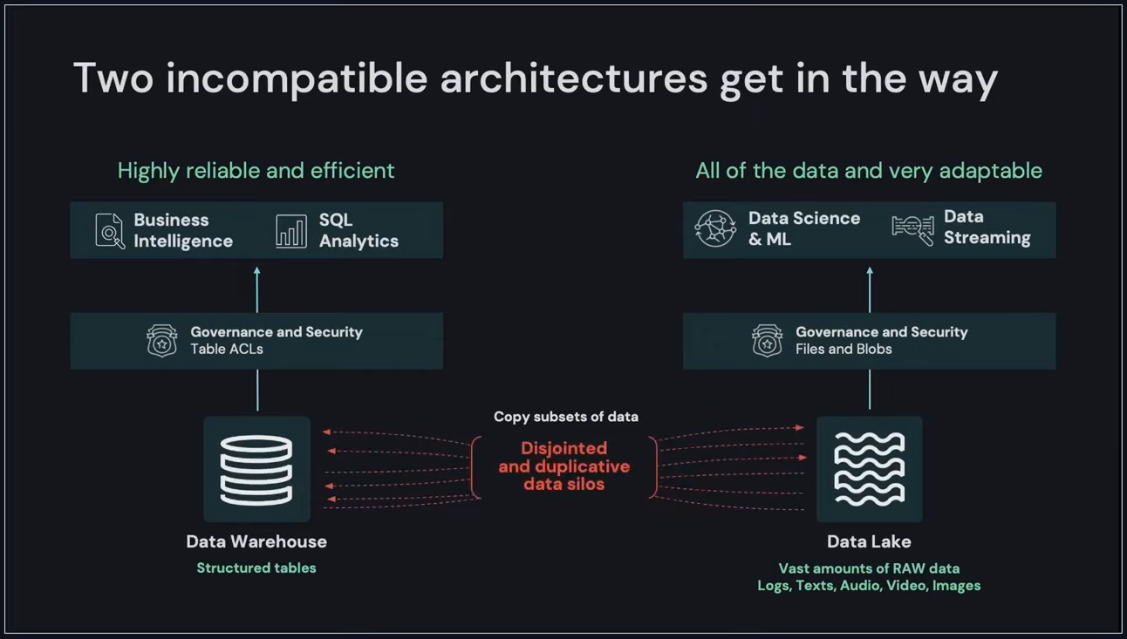
Lakehouse Motivation (3/4)
Source: Data & AI Summit 2022 Keynote
Notes:
Clusters are set up, configured, and fine-tuned to ensure reliability and performance without the need for monitoring.

Slide 18
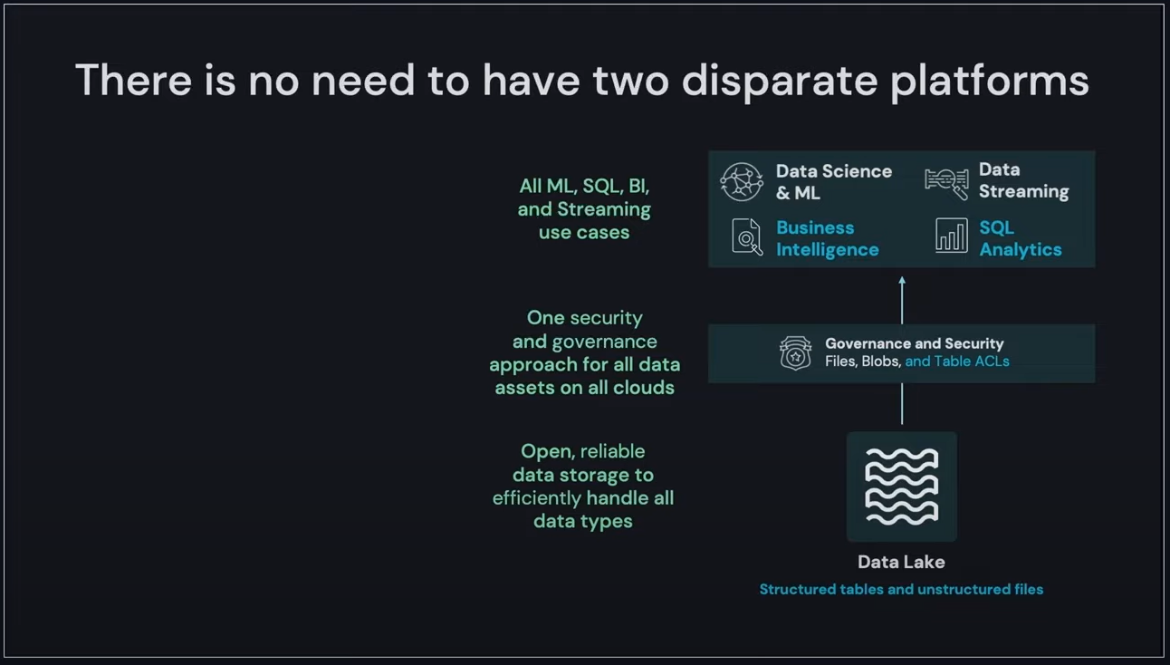
Lakehouse Motivation (4/4)
Source: Data & AI Summit 2022 Keynote
Notes:
Clusters are set up, configured, and fine-tuned to ensure reliability and performance without the need for monitoring.

Slide 19
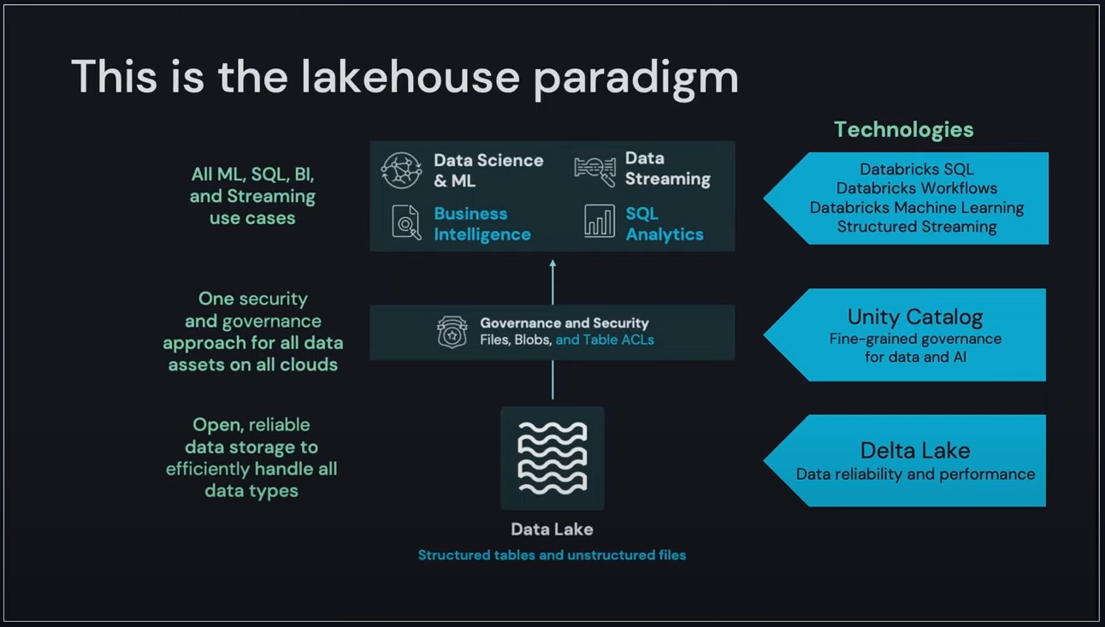
Databricks Lakehouse (1/3)
Source: Data & AI Summit 2022 Keynote
Notes:
Clusters are set up, configured, and fine-tuned to ensure reliability and performance without the need for monitoring.

Slide 20
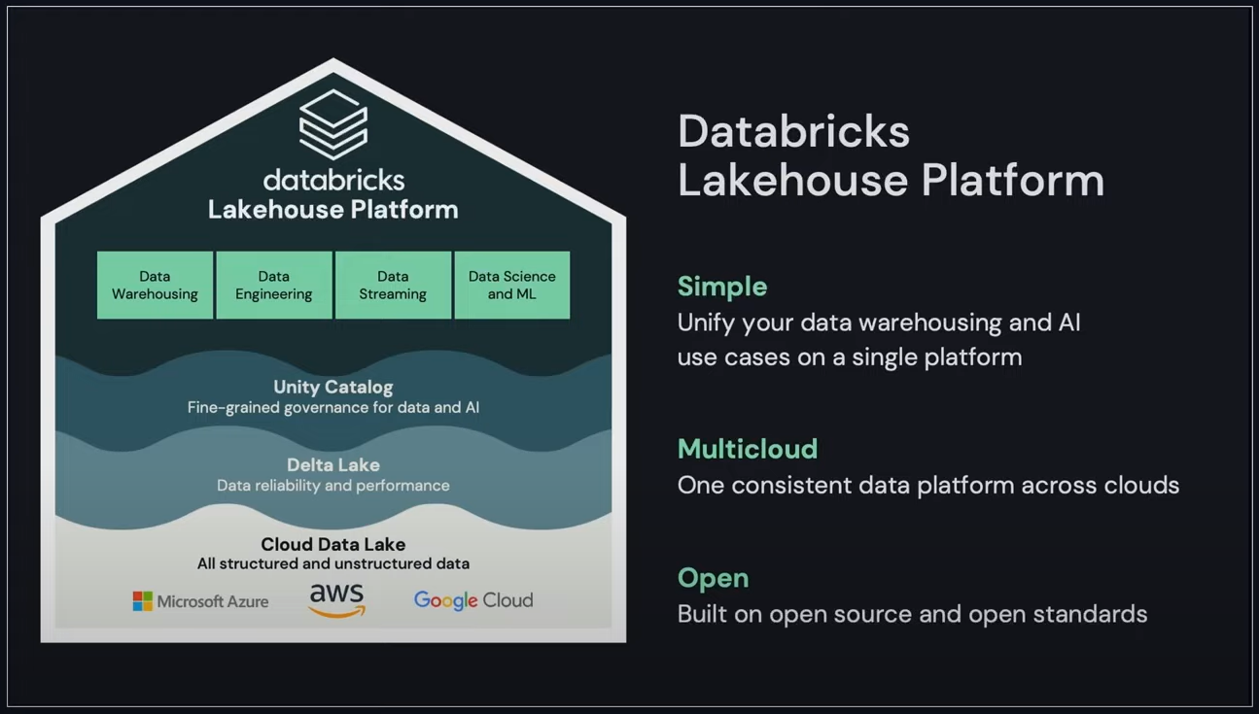
Databricks Lakehouse (2/3)
Source: Data & AI Summit 2022 Keynote
Notes:
Clusters are set up, configured, and fine-tuned to ensure reliability and performance without the need for monitoring.

Slide 21
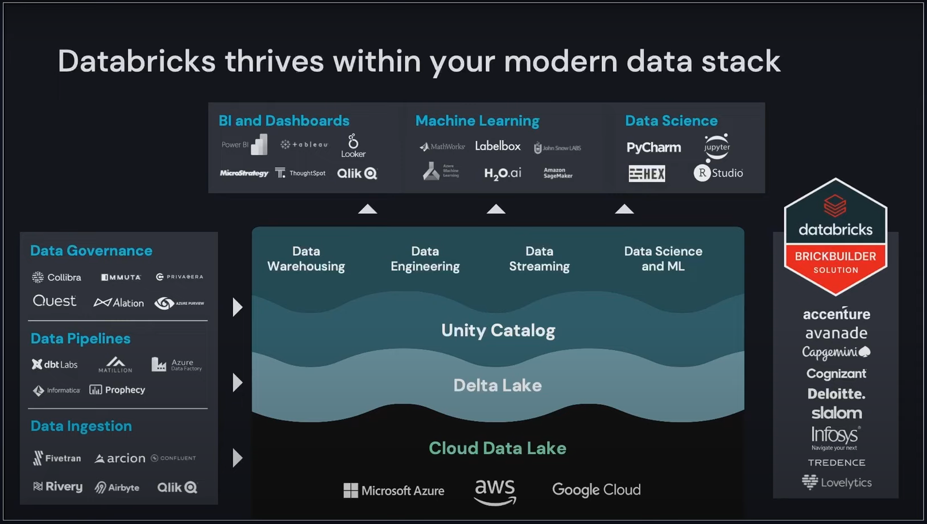
Databricks Lakehouse (3/3)
Source: Data & AI Summit 2022 Keynote
Notes:
Clusters are set up, configured, and fine-tuned to ensure reliability and performance without the need for monitoring.

Slide 22
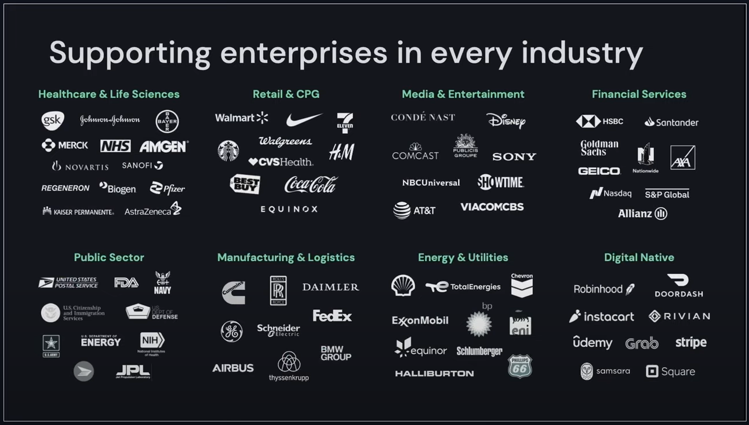
Databricks Industry Offerings
Source: Data & AI Summit 2022 Keynote
Notes:
Clusters are set up, configured, and fine-tuned to ensure reliability and performance without the need for monitoring.

Slide 23
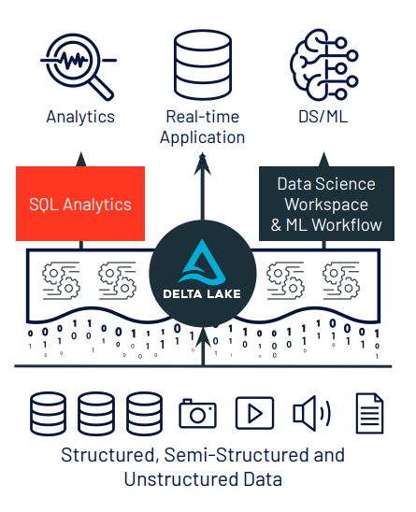
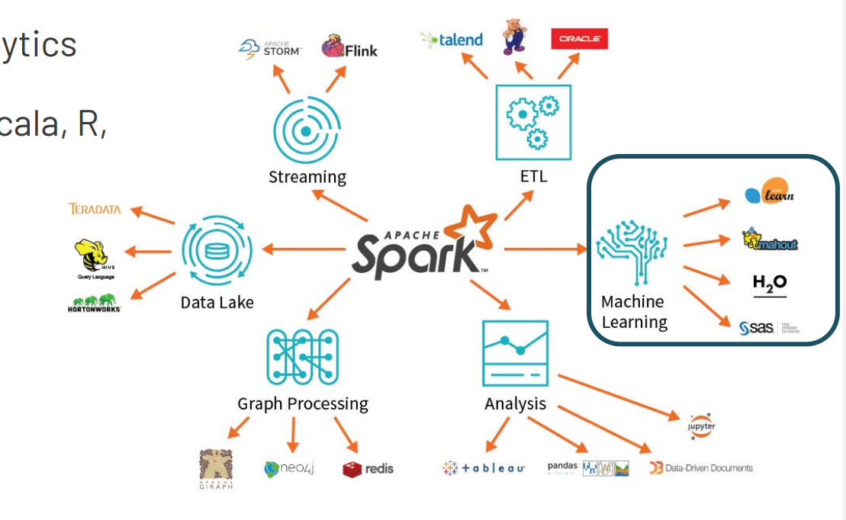
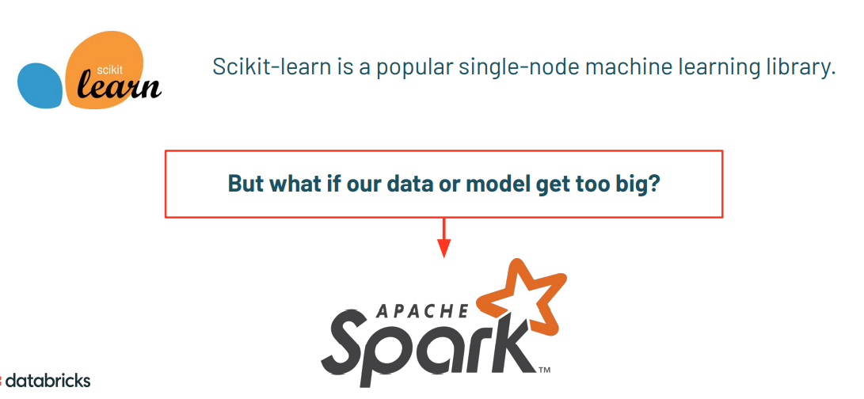
Azure Databricks Apache Spark + Databricks + Enterprise Cloud = Azure Databricks
Start quickly with an optimized Apache Spark environment: Just spin up a cluster and take advantage of autoscaling and auto-termination to improve TCO.
Boost productivity with a shared workspace and notebook experience as well as common languages such as Python, Scala, SQL and R.
Get easy version control with GitHub and Azure DevOps
Turbocharge machine learning on big data: Make use of the Spark MLlib, scikit learn, keras (...) or access advanced automated machine learning capabilities using the integrated Azure Machine Learning service
Receive unmatched levels of performance and scalability for big data processing and data transformations
Notes:
Clusters are set up, configured, and fine-tuned to ensure reliability and performance without the need for monitoring.

Slide 24
Azure Databricks Apache Spark + Databricks + Enterprise Cloud = Azure Databricks
Start quickly with an optimized Apache Spark environment: Just spin up a cluster and take advantage of autoscaling and auto-termination to improve TCO.
Boost productivity with a shared workspace and notebook experience as well as common languages such as Python, Scala, SQL and R.
Get easy version control with GitHub and Azure DevOps
Turbocharge machine learning on big data: Make use of the Spark MLlib, scikit learn, keras (...) or access advanced automated machine learning capabilities using the integrated Azure Machine Learning service
Receive unmatched levels of performance and scalability for big data processing and data transformations
Notes:
Clusters are set up, configured, and fine-tuned to ensure reliability and performance without the need for monitoring.

